Slide 1
Lesson Planning for Biblical Worldview
4 Approaches
Notes:
Applaud you all.

Slide 2
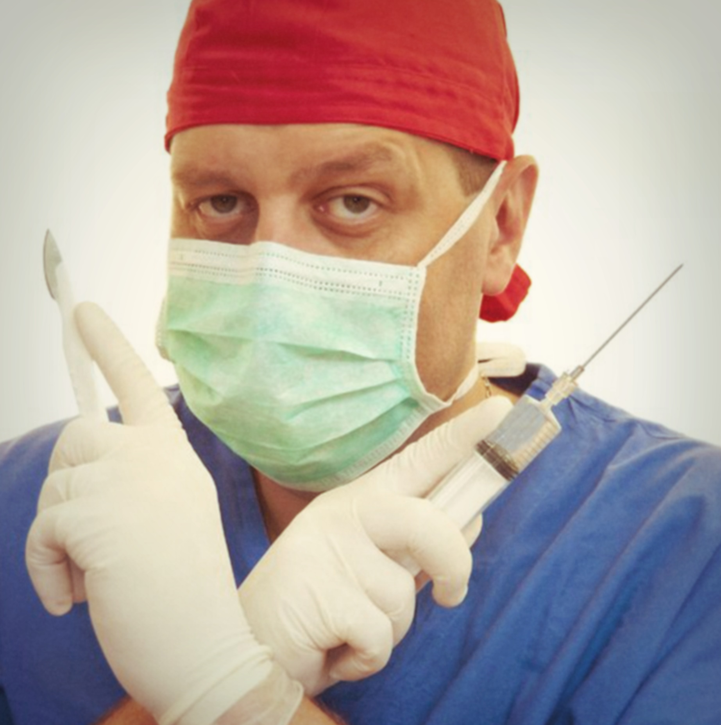

Slide 4
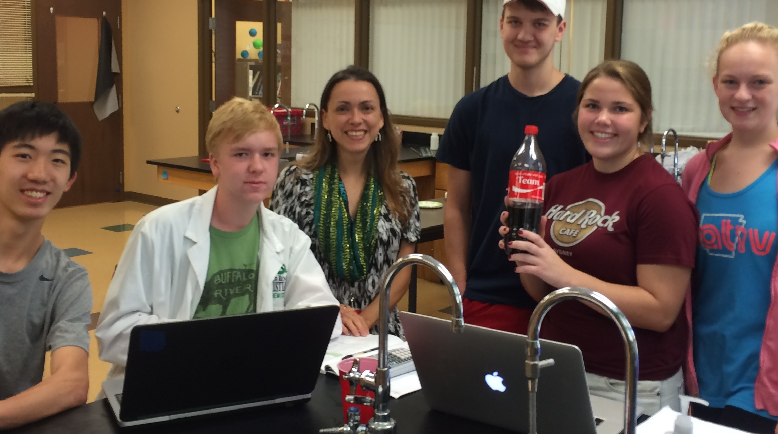
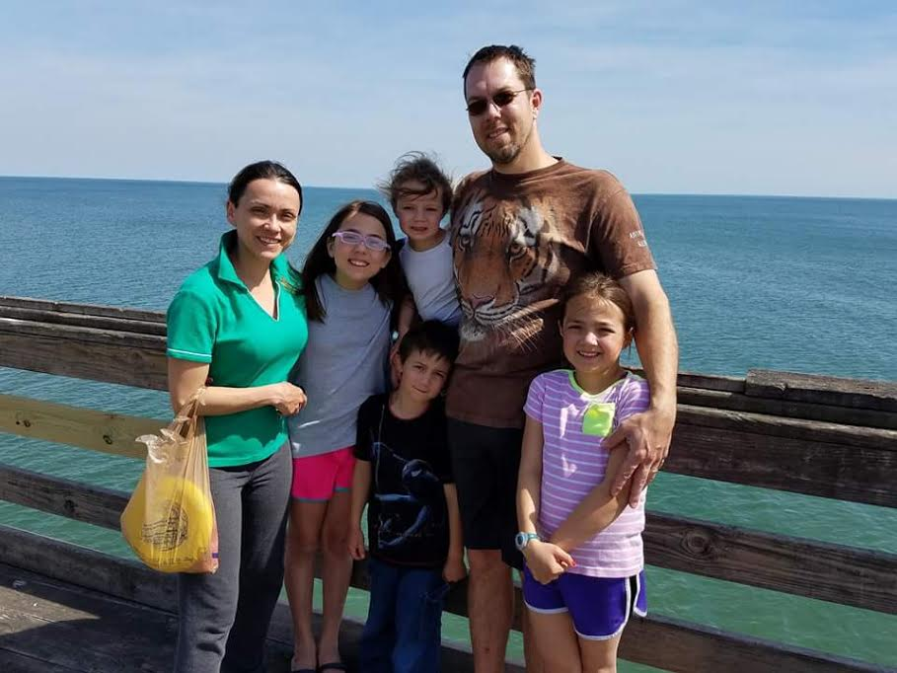
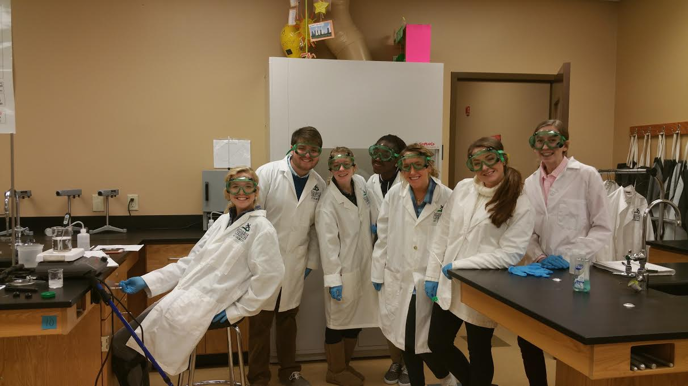
Notes:
Olguita, math teacher, second grade at Greenville Christian (ironic): It is just who we are.
Matt Dominguez.

Slide 5
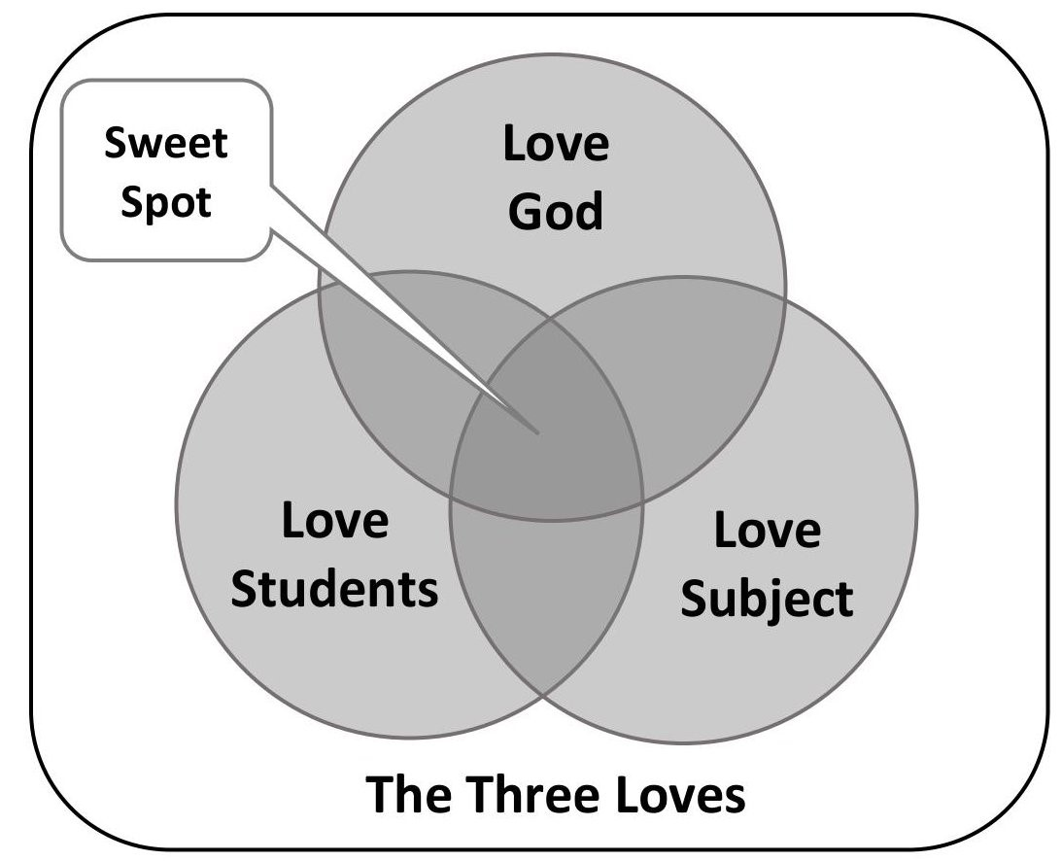

Slide 6
Power of Love
“I know your deeds and your toil and perseverance, and that you cannot tolerate evil men…But I have this against you, that you have left your first love… Repent and do the deeds you did at first.” Revelation 2:2,4, and 5.
“For in Christ Jesus neither circumcision nor uncircumcision means anything, but faith working through love. You were running well; who hindered you from obeying the truth?” Galatians 5:6-7
“For you were called to freedom, brethren, only do not turn your freedom into an opportunity for the flesh, but through love serve one another...Love your neighbor as yourself.” Galatians 5:13-14
“If I speak with the tongues of men and angels, but do not have love, I have become a noisy gong or a clanging cymbal…I am nothing…it profits me nothing.” 1 Corinthians 13:1-3
Notes:
Power of love, no wall, no border, no person can stop it.
Subversiion… Junior Sapato…
Jesus changed the world.

Slide 7
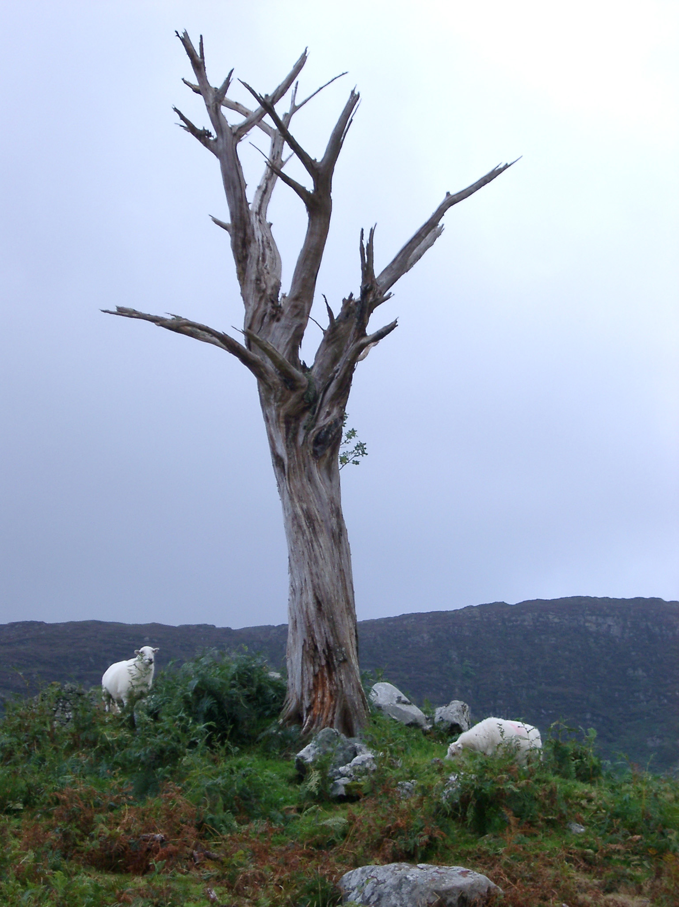
What are we after?
Notes:
What are we after?
What are the advantages and disadvantages of each of these?
How do you create each?
Which is closer to a biblical view of what we are after in students? Explain.

Slide 8
Notes:
It’s about them. What BWV does to them.
Backward mapping…Moses did it.

Slide 9
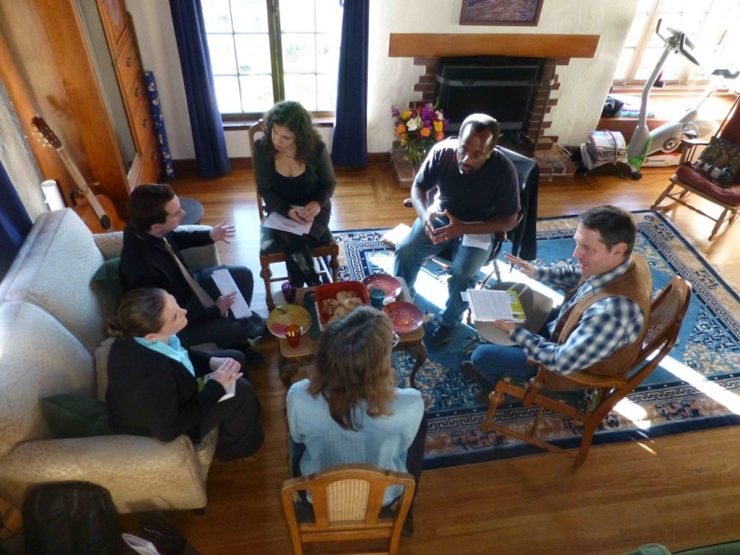
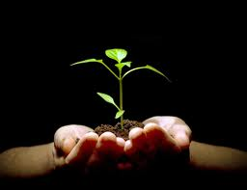
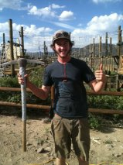
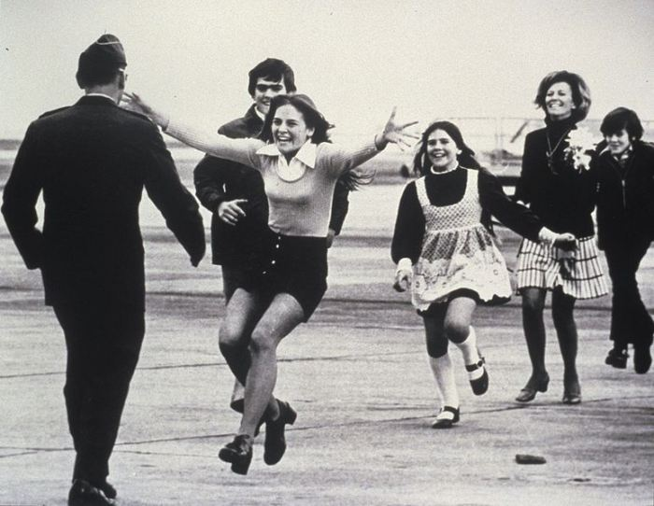
Overflowing

Slide 10
Benefits
Points to Jesus.
Makes the Bible foundational.
Pursues truth.
Draws to God.
Excites learning.
Brings unity.
Asks and answers questions.

Slide 12
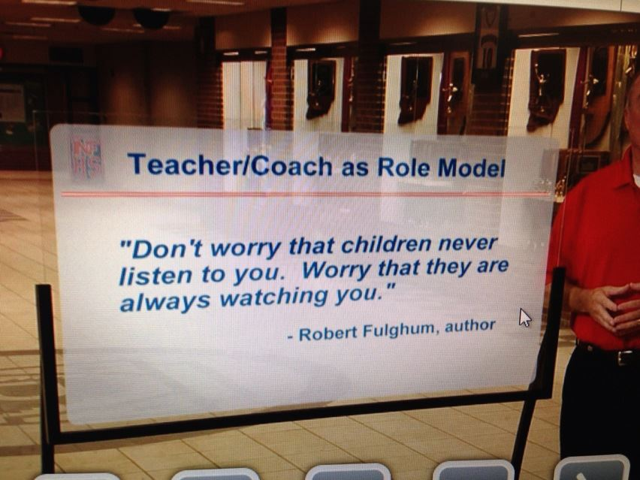
Being a Teacher
“A pupil is not above his teacher; but everyone, after he has been fully trained, will be like his teacher.” Luke 6:40
“Let not many of you become teachers, my brethren, knowing that as such we will incur a stricter judgment.” James 3:1
“You are our letter, written in our hearts, known and read by all men, being manifested that you are a letter of Christ, cared for by us, written not with ink but with the Spirit of the living God, not on tablets of stone but on tablets of human hearts.” 2 Corinthians 3
What do we want in a teacher?
Love. For God, students, and subject?
Gift of teaching?
Called?
What else?
Notes:
In a culture that glorifies negative role models, I hope I can make a difference. 😍 On another note, Guess what I'm doing ALL day? Online professional development... *bangs head on desk*

Slide 13
Notes:
It’s about them. What BWV does to them.
Backward mapping…Moses did it.

Slide 14
Plans—4? for lessons
1. Life with God in the classroom and out that overflows? Deuteronomy 6.
2. Does the Bible say anything about the subject? Specific or themes. Bible.
3. Does the subject point to God and draw students to Him? Subject.
4. Can you use the subject to apply a biblical truth or reach a biblical goal?

Slide 15
Truth in life
Life with God in the classroom and out that overflows? Deuteronomy 6.
“They will know we are Christians by the love for one another.”
Joy, truth, power in life, learning, growing in knowledge and passions, how to love God’s way, appreciation of all things about Him.
Relationship. With God and with each other. Keep it clean.
What is God doing in your heart, teaching you, show them that love and learning affect you and change you.
Holy Spirit. Pray for open eyes.

Slide 16
The Bible Speaks
Does the Bible say anything about the subject?
Could be specifics or themes (for example, patterns in Mathematics).
Use what you know, but always be looking and learning.
Use tools: books, searches, bible study.
Create a library but don’t rely on others. First hand with living Word.
Bible is the beginning point.
Collaborate with others, in person or online.
Keep eyes open. Pray. Ask students to help!

Slide 17
The Subject Points
Does the subject point to God and draw students to Him?
What do you know about God, people, world, salvation…confidence.
Uses other truth and ideas than the Bible as the beginning point.
Les Miserables, quantum physics wave collapse, Jim Dine in “Ten Formal Fingers.

Slide 18
The Subject Used
Can you use the subject to apply a biblical truth or reach a biblical goal?
Involves using subject truth and content to apply specific passages or themes. Can we use the subject for God’s purposes in life?
What are God’s desires? Big picture. Justice. Mercy. Humility. Salvation. Heal. Keeping adding.
Does your subject or truth find a place in these. Olguita’s water purification.

Slide 19
3 ? for the teacher every day
1. How will my students know I love God today?
2. How will my students know I love them today?
3. How will my students know I love the subject, the truth I give them, today?
“But the goal of our instruction is to love from a pure heart and a good conscience and a sincere faith.” 1 Timothy 1:5

Slide 20
A few resources
The Reclaiming the Christian Intellectual Tradition series by crossway.org.
Encyclopedia of Bible Truths by Ruth Haycock, ACSI
Transformingteachers.org: Harold Klassen, “Visual Valet” and more.
Biblicalintegration.com: Mark Eckel, lesson planning and more.
WheatonPress.com.
Nice.edu.au. Interesting and fresh work in Australia.

Slide 21
What’s next?
What does God say about teaching, a biblical worldview?
Plans.
Dream.
Trust.
Pray.

Slide 23
How to grow teachers for BWV?
1. What top qualities, strengths, knowledge, skills, or attitudes do teachers need to teach biblical worldview in their classrooms day after day?
2. What can we do to help them grow in these areas, short term and long term?

Slide 24
How to create a culture for great BWV?
1. What handful of intentional directions reflected in daily habits (culture) would help provide biblical worldview that changes student lives?
2. How do we make those happen, to sustain great biblical worldview over time?

Slide 25
Suggestions for culture change
Lead by example: do it!
Clarify expectations. Evaluate it. Mean it.
Applaud those doing it and give courage to those who need it. 1 Thes. 5:14
Engage in small and big ways, part of conversation, ask the question.
Embed it. Intentional. Lean.
Leverage. Trust.
Give permission, strongly. And, expectation.
Neutralize toxicity.

Slide 26
